Slide 1

Miracle makers’ pet adoption
hEllo-world – women in foss

Slide 2
About the product
We are Miracle Makers. This pet adoption front-end website is build using HTML, CSS and JavaScript
This application mainly consist of 5 parts
1. Homepage
2. Photo gallery of pets to be adopted
3. Application for adoption
4. The about us page
5. The contact us page

Slide 3
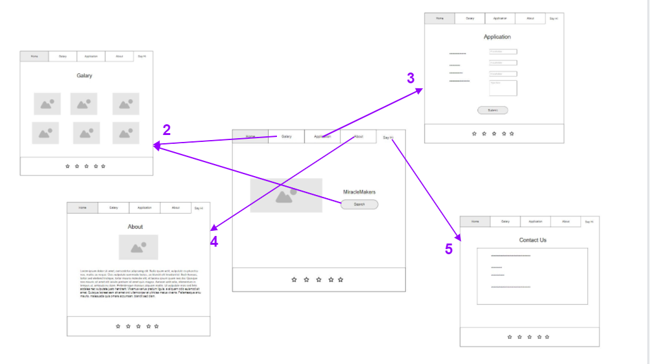

UI connection of the pages

Slide 4
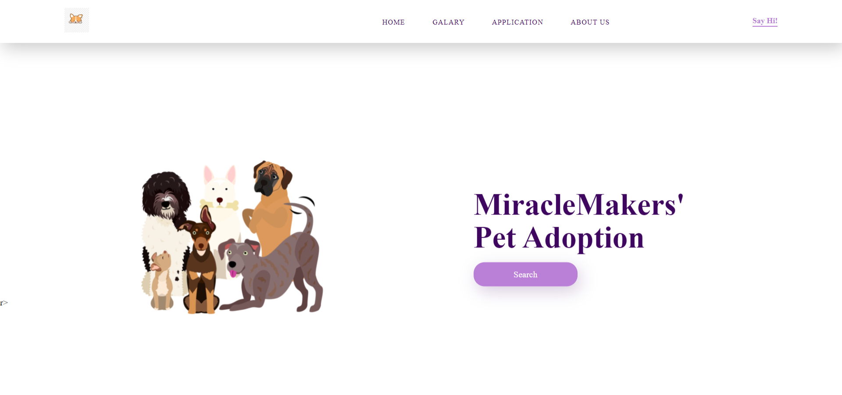
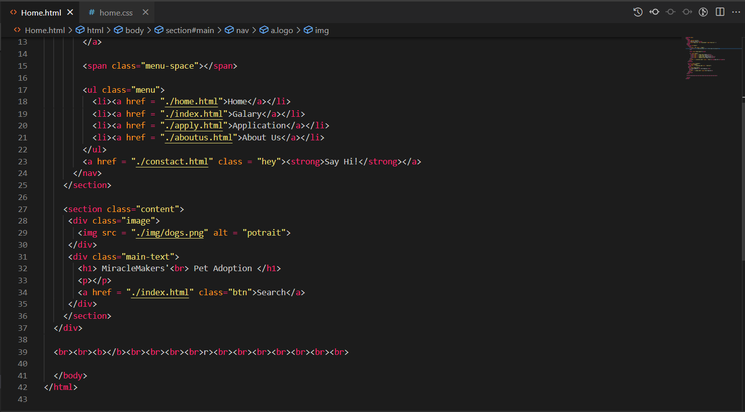
1. Homepage

Slide 5
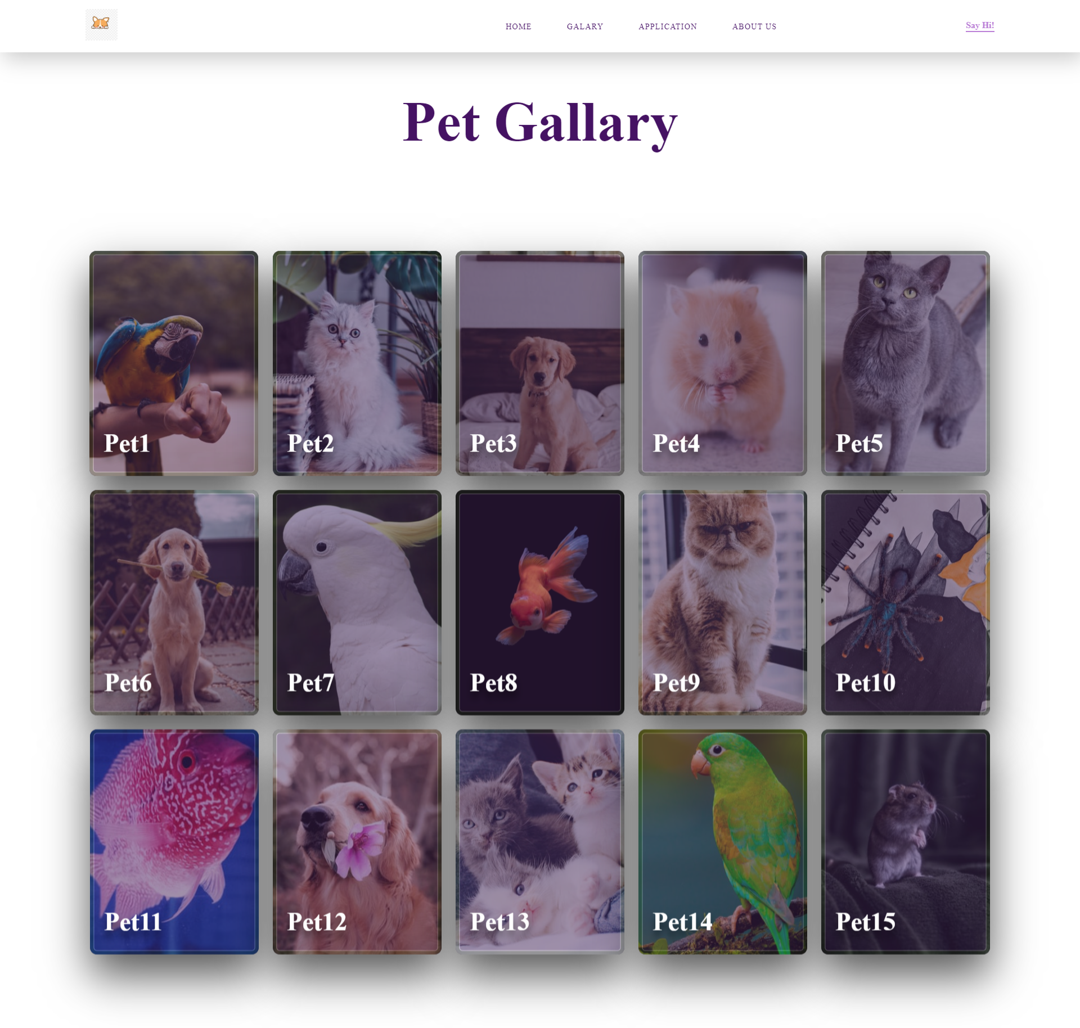
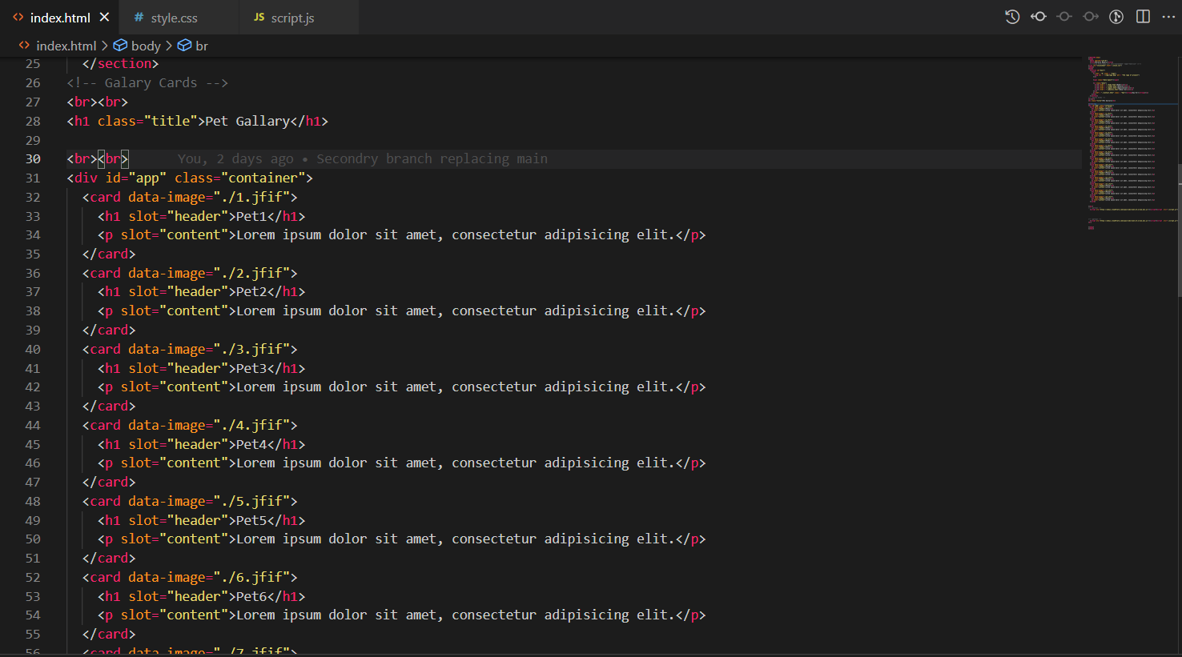
2. Photo gallery of pets to be adopted

Slide 6
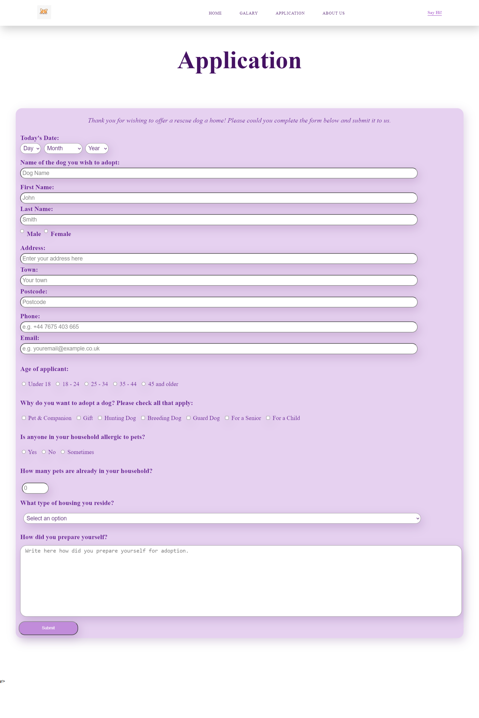
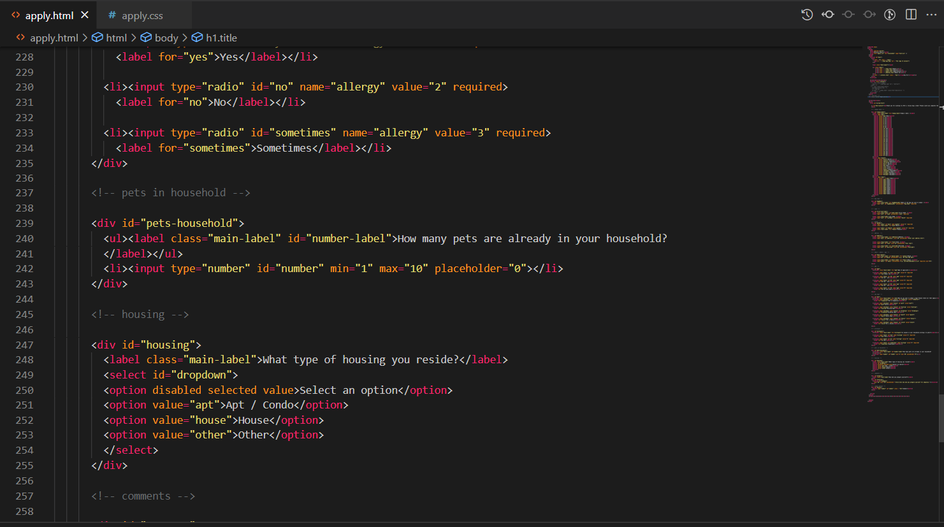
3. Application for adoption

Slide 7
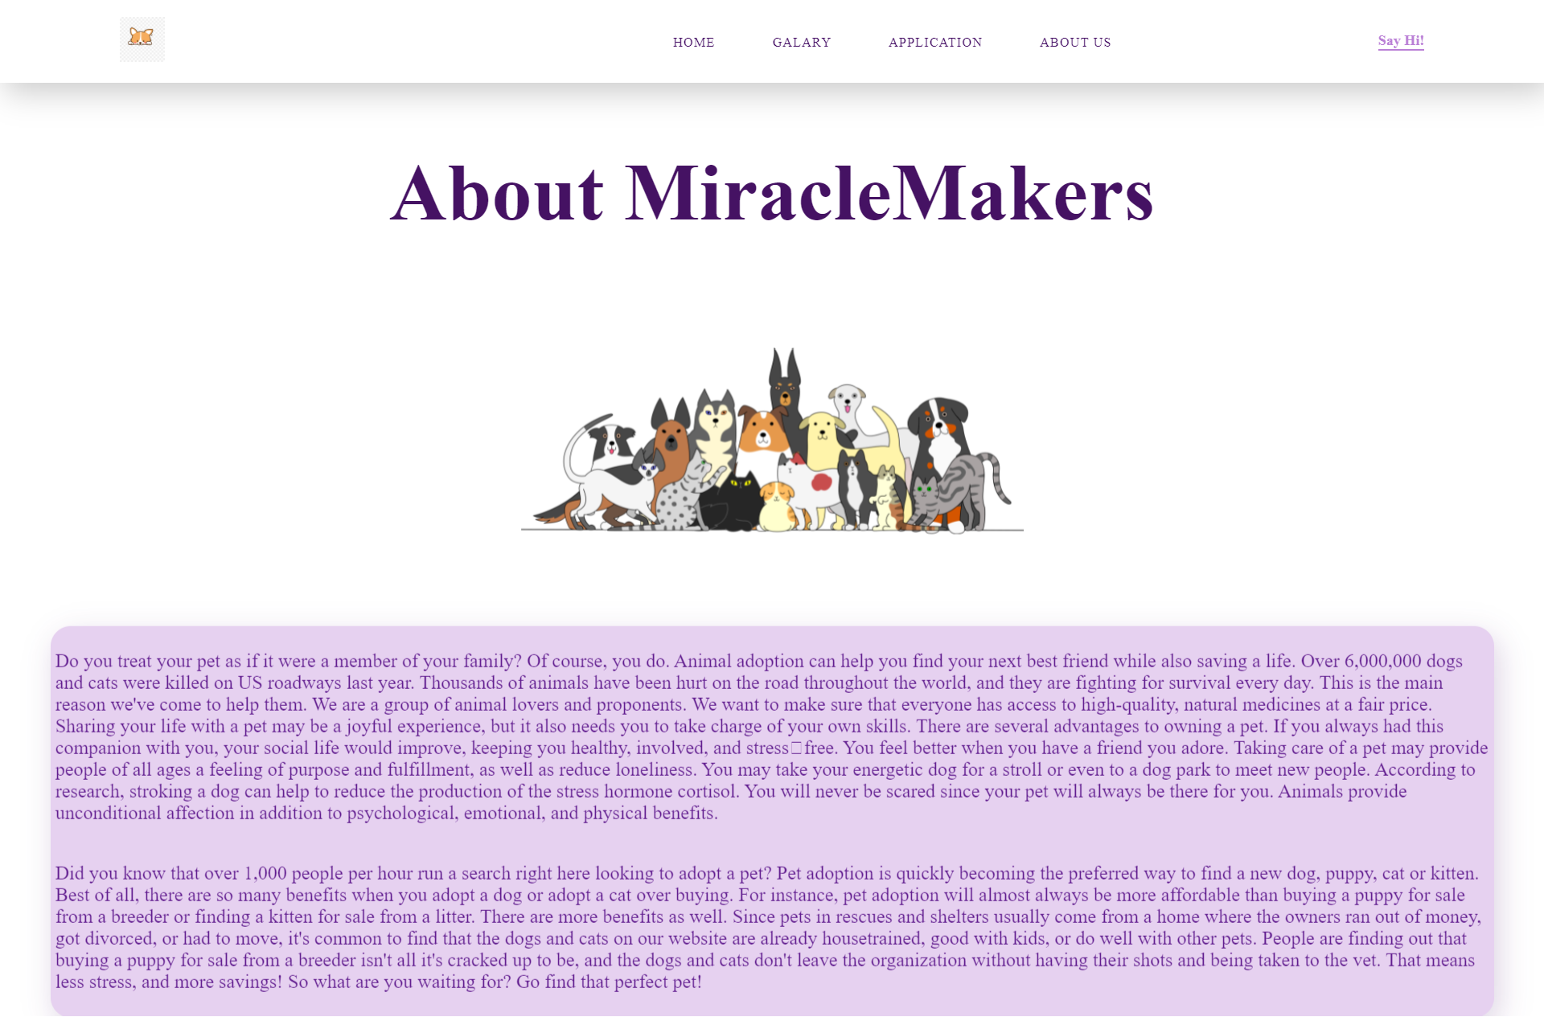
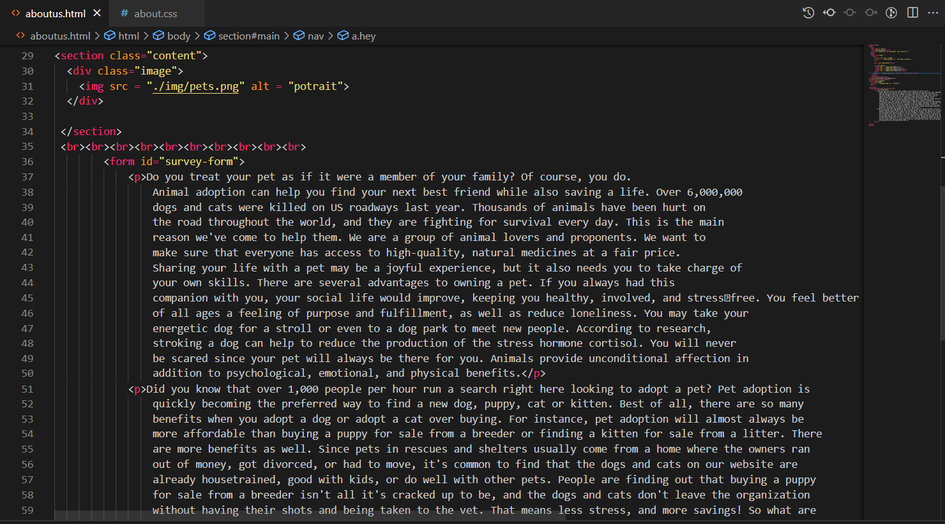
4. About us

Slide 8
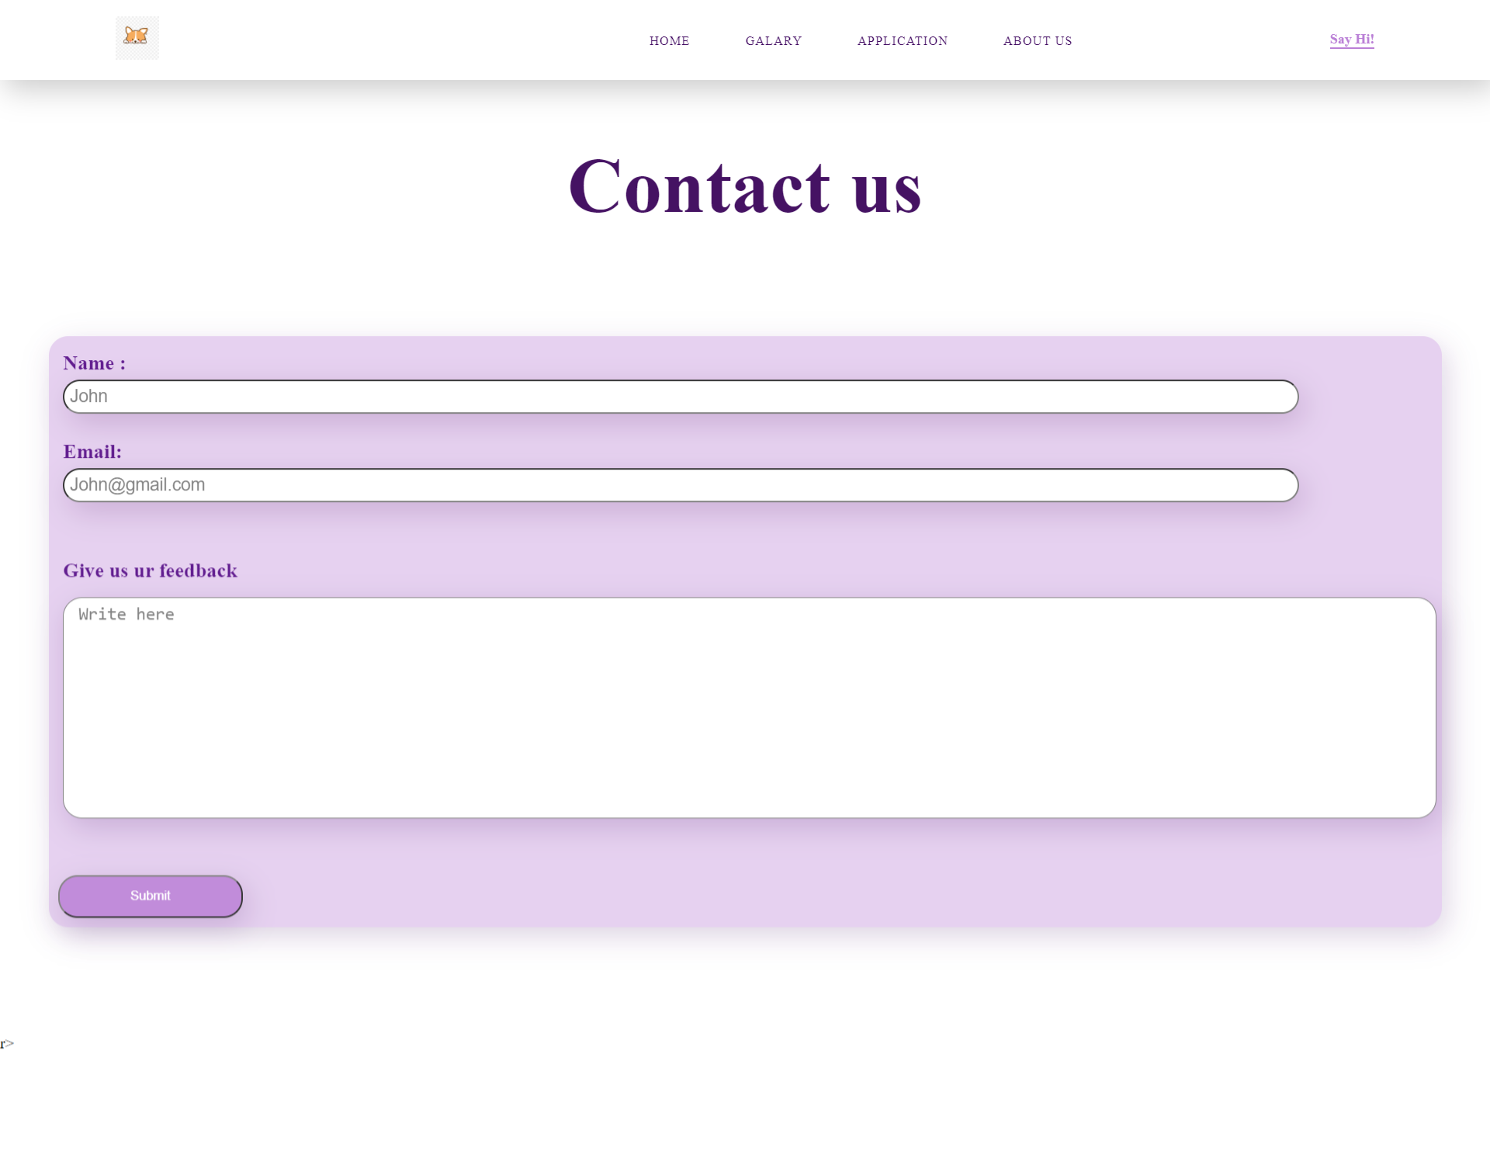
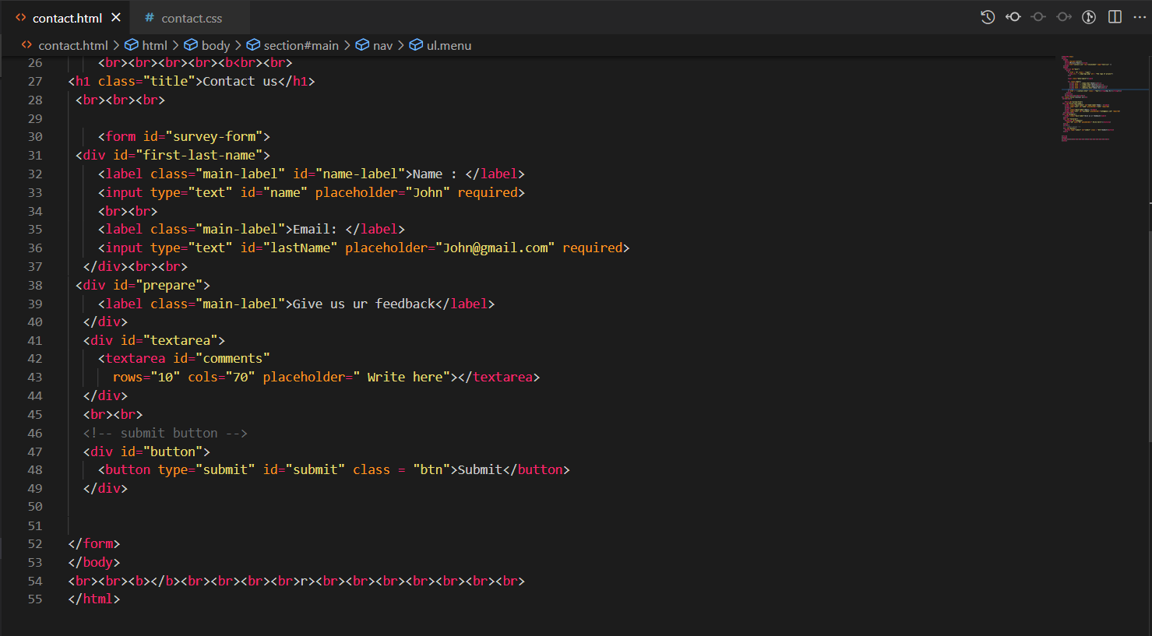
5. Contact us

Slide 9
The end

